Slide 1

Topic: Measurement
EQ: How do we work out the surface area of composite prisms?

Slide 2
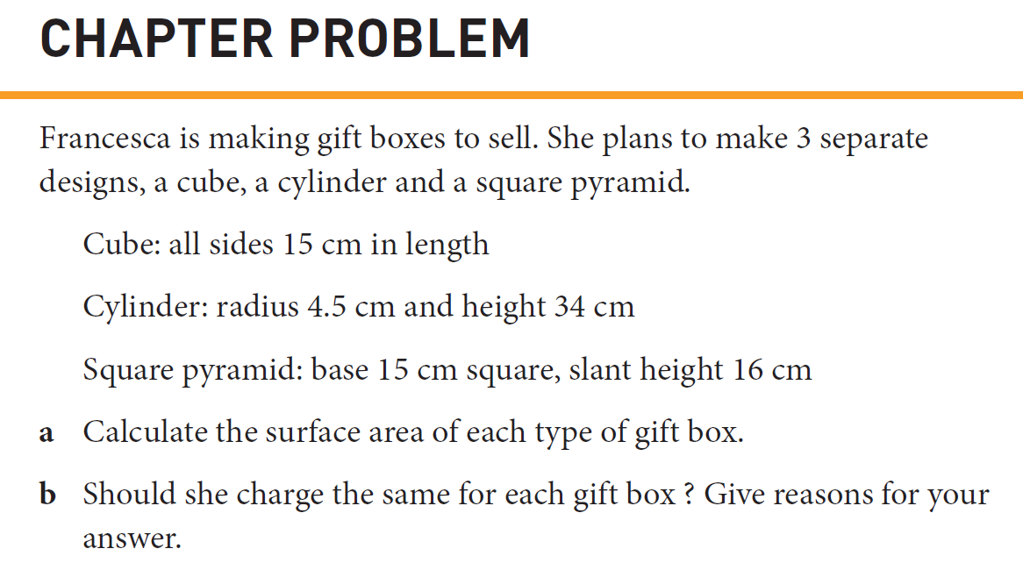

Slide 3
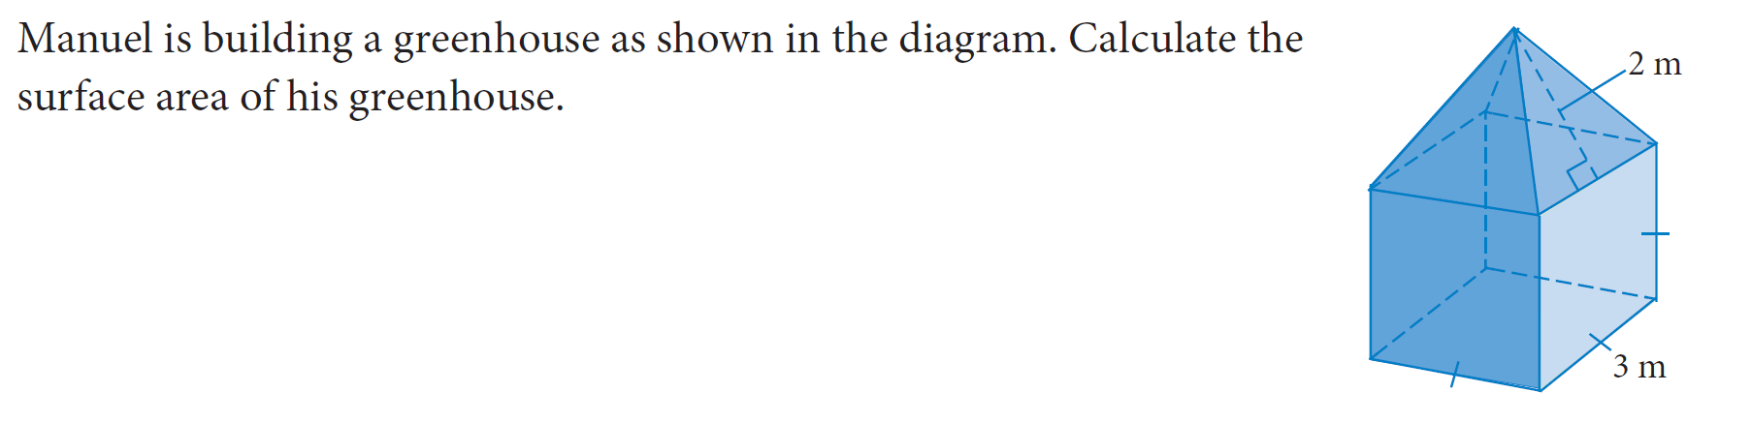

Slide 4
